Slide 1
Data and Models
E²M²: Ecological and Epidemiological Modeling in Madagascar
Centre ValBio
Ranomafana National Park, Madagascar
December 2022

Slide 2


Thanks to our sponsors!
Lecture contributions from:
Tanjona Ramiadantsoa
Steve Bellan

Slide 3
Goals for this lecture
To explain what we’re doing here

Slide 4
Goals for this lecture
To explain what we’re doing here
To define “science”

Slide 5
Goals for this lecture
To explain what we’re doing here
To define “science”
To define “data”

Slide 6
Goals for this lecture
To explain what we’re doing here
To define “science”
To define “data”
To define “models”

Slide 7
Goals for this lecture
To explain what we’re doing here
To define “science”
To define “data”
To define “models”
To introduce many different types of models

Slide 8
Goals for this lecture
To explain what we’re doing here
To define “science”
To define “data”
To define “models”
To introduce many different types of models
Statistical

Slide 9
Goals for this lecture
To explain what we’re doing here
To define “science”
To define “data”
To define “models”
To introduce many different types of models
Statistical
Mathematical

Slide 10
Goals for this lecture
To explain what we’re doing here
To define “science”
To define “data”
To define “models”
To introduce many different types of models
Statistical
Mathematical
To introduce the “E” in E²M²

Slide 11
Goals for this lecture
To explain what we’re doing here
To define “science”
To define “data”
To define “models”
To introduce many different types of models
Statistical
Mathematical
To introduce the “E” in E²M²
Ecology

Slide 12
Goals for this lecture
To explain what we’re doing here
To define ”science”
To define ”data”
To define “models”
To introduce many different types of models
Statistical
Mathematical
To introduce the “E” in E²M²
Ecology
Epidemiology

Slide 13
All course materials are available at:
E2M2.org

Slide 14
Friday: R Bootcamp
Intro to R Studio
Exploring and Visualizing Data in R
For-loops, Functions, and If-Else Statements
● Programming
● Data
● Models
● Research Development
Thursday: “Bells and Whistle”
● Introduction to Phylogenetic Modeling ● Tutorial
● Intoduction to Spatial Visualization and Plotting ● Tutorial
● Modeling Insights from the Metapopulation Game ● Tutorial
● Introduction to Network Modeling ● Tutorial
● Research Snapshots
Saturday: Travel
Sunday: “Getting Started with the Basics”
● Data and Models
● Student introductions & presentations
● Linear regression & simple statistics
● Linear regression tutorial
● Formulating research questions
Wednesday: “Refining Your Work”
● Model Fitting in Practice – the Basic Concept
● Epidemic Cards
● Model Fitting with Epidemic Cards
● Model Selection and Comparison
● Model Selection Tutorial
● Model Telephone
Friday: “Putting it All in Perspective”
● The Life Cycle of a Modeling Project
● C4C Student Presentations
Saturday: Travel
Monday: “Using Models with Data”
● Model-Guided Study Design
● Study design tutorial
● Intro to Compartmental Models & Differential Equations
● Building mechanistic models in R
● Refining research questions for modeling
● Defining a model world
January: “Sharing Your Work”
● Final student presentations
Tuesday: “Applying Simple Models”
● Dynamical Fever
● Introduction to Mixed Modeling
● Reading a Research Paper

Slide 15
What is science?

Slide 16
What is science?
the systematic observation of natural events and conditions in order to discover facts about them and to formulate laws and principles based on these facts.
– Academic Press Dictionary of Science & Technology

Slide 17
What is science?
the systematic observation of natural events and conditions in order to discover facts about them and to formulate laws and principles based on these facts.
– Academic Press Dictionary of Science & Technology

Slide 18
Observations and Laws and Principles

Slide 19
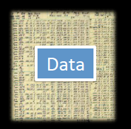
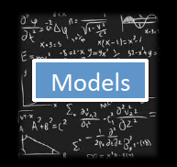
Data and Models
Models

Slide 20
Data and Models
What are data?

Slide 21
Data and Models
What are data?
Backbone of science
Evidence to support a claim

Slide 22
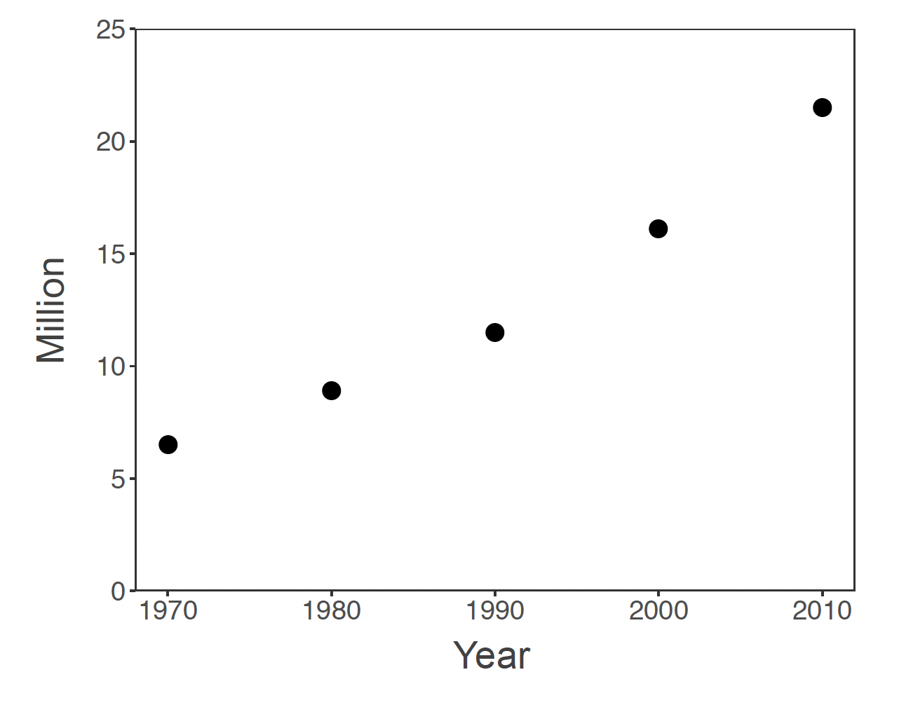
Are these data?

Slide 23
Are these data?
What do we need to make these data?

Slide 24
Are these data?

Slide 25
Are these data?

Slide 26
Are these data?

Slide 27
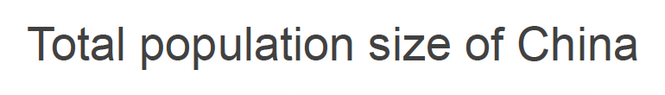
Are these data?

Slide 28
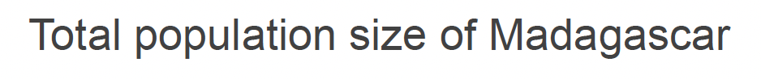
Are these data?

Slide 29
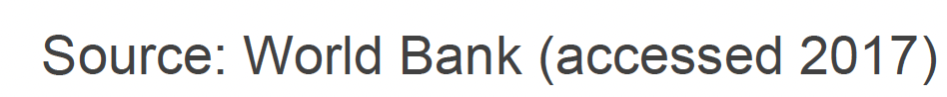
Are these data?

Slide 30
What are data?
A relationship between at least two variables
x: explanatory, control, driver, independent variable(s)
y: response, dependent variable(s)
x and y should be clearly defined
with respect to the question!
Backbone of science
Evidence to support a claim

Slide 31
What are data?
A relationship between at least two variables
x: explanatory, control, driver, independent variable(s)
y: response, dependent variable(s)
x and y should be clearly defined
with respect to the question!
Backbone of science
Evidence to support a claim

Slide 32
What are data?
A relationship between at least two variables
x: explanatory, control, driver, independent variable(s)
y: response, dependent variable(s)
x and y should be clearly defined
with respect to the question!
Evidence to support a claim

Slide 33
Data provide evidence to support a claim.
Backbone of science
CLAIM: The population size of Madagascar has increased throughout the past 50 years

Slide 34
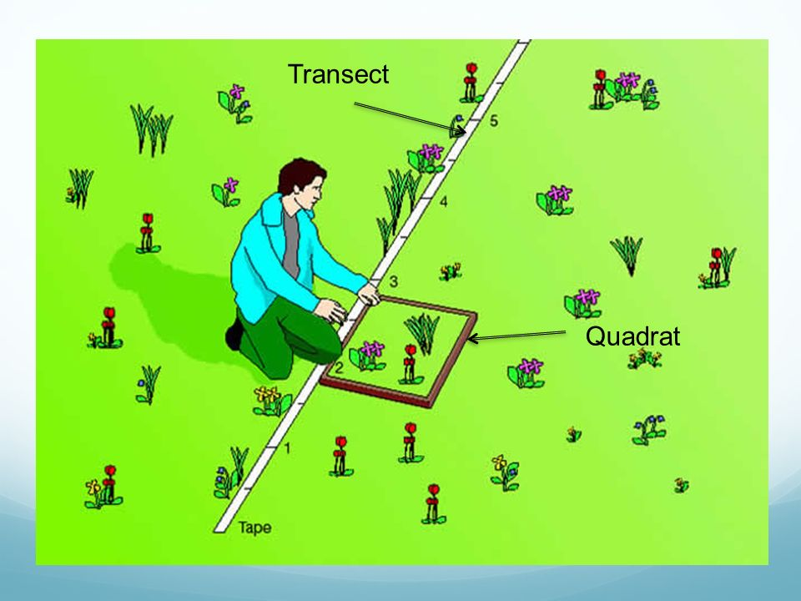
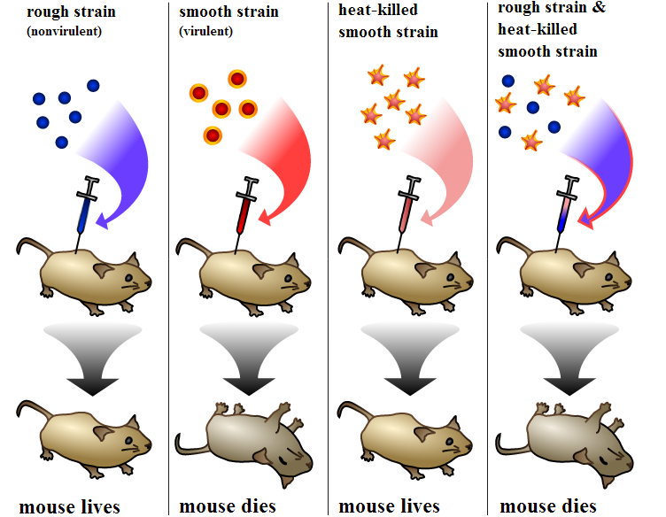
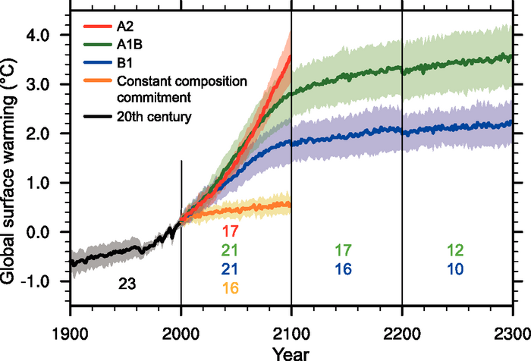
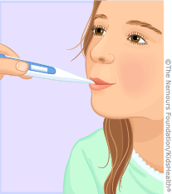
Data: Sources of x and y
Observational | Experimental | Simulated
- Just measure x and y | - Interfere with x or the relationship between x and y | - Create a relationship between x and y
Empirical data

Slide 35
Data: Types
Numerical
Categorical

Slide 36
Data: Types
Numerical
A variable is numerical when you can transform it with mathematical operation
Examples?
Categorical

Slide 37
Data: Types
Numerical
A variable is numerical when you can transform it with mathematical operation
Examples:
Integer, real number, multi-dimensional number
Categorical

Slide 38
Data: Types
Numerical
A variable is numerical when you can transform it with mathematical operation
Examples:
Integer, real number, multi-dimensional number
Categorical
A variable is categorical when it is not numerical but a categorical can be numerical?
Examples?

Slide 39
Data: Types
Numerical
A variable is numerical when you can transform it with mathematical operation
Examples:
Integer, real number, multi-dimensional number
Categorical
A variable is categorical when it is not numerical but a categorical can be numerical?
Examples:
Colors, (blood) types, species name

Slide 40
Data: Things to consider
Data acquisition

Slide 41
Data: Things to consider
Data acquisition
Impossible, example?

Slide 42
Data: Things to consider
Data acquisition
Impossible, example?
Theoretically possible but practically unfeasible, examples?

Slide 43
Data: Things to consider
Data acquisition
Impossible, example?
Theoretically possible but practically unfeasible, examples?
Data quality and quantity
In practice there is always a trade-off

Slide 44
Data: Things to consider
Data acquisition
Impossible, example?
Theoretically possible but practically unfeasible, examples?
Data quality and quantity
In practice there is always a trade-off
Example: monetary cost, human effort -> power analysis, sampling design etc.

Slide 45
Data: Things to consider
Data acquisition
Impossible, example?
Theoretically possible but practically unfeasible, examples?
Data quality and quantity
In practice there is always a trade-off
Example: monetary cost, human effort -> power analysis, sampling design etc.
Reproducibility

Slide 46
Data: Things to consider
Data acquisition
Impossible, example?
Theoretically possible but practically unfeasible, examples?
Data quality and quantity
In practice there is always a trade-off
Example: monetary cost, human effort -> power analysis, sampling design etc.
Reproducibility
Measurement errors

Slide 47
Data: Things to consider
Data acquisition
Impossible, example?
Theoretically possible but practically unfeasible, examples?
Data quality and quantity
In practice there is always a trade-off
Example: monetary cost, human effort -> power analysis, sampling design etc.
Reproducibility
Measurement errors
Examples?

Slide 49
Data and Models
Models

Slide 50
Data and Models
Models
What is a model?

Slide 51
What is science?
the systematic observation of natural events and conditions in order to discover facts about them and to formulate laws and principles based on these facts.
– Academic Press Dictionary of Science & Technology

Slide 52
Laws and Principles
Theory General
Model
Hypothesis Specific

Slide 53
Laws and Principles
Theory General
Model
Hypothesis Specific
a declaration to explain a phenomenon

Slide 54
Laws and Principles
Theory General
Model
Hypothesis Specific
a declaration to explain a phenomenon
an abstract representation of a phenomenon

Slide 55
Laws and Principles
Theory General
Model
Hypothesis Specific
a declaration to explain a phenomenon
an abstract representation of a phenomenon
a testable declaration that is derived from a theory

Slide 56

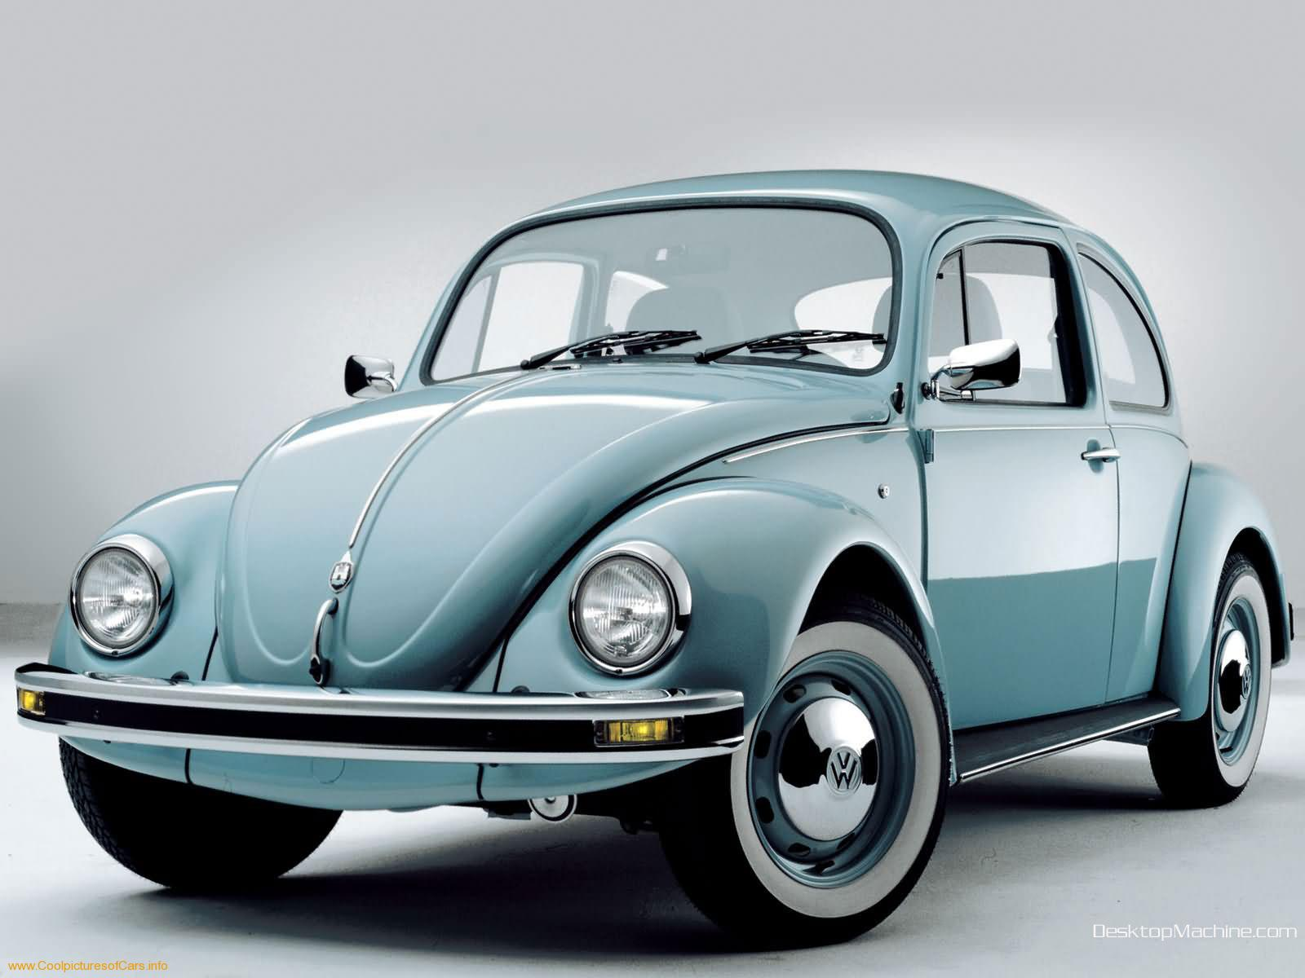
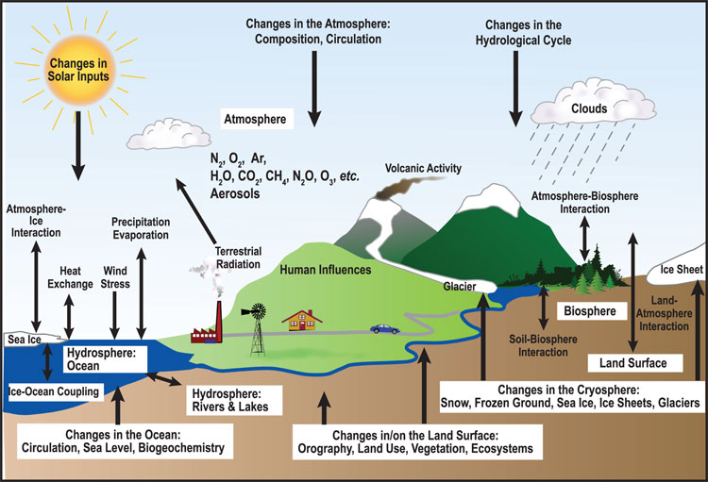
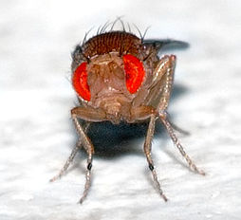
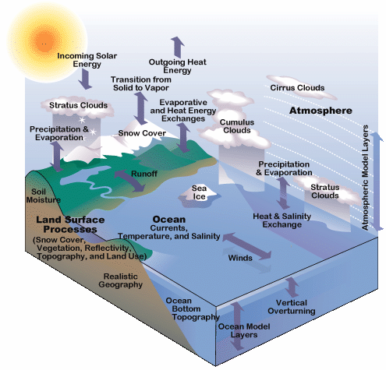
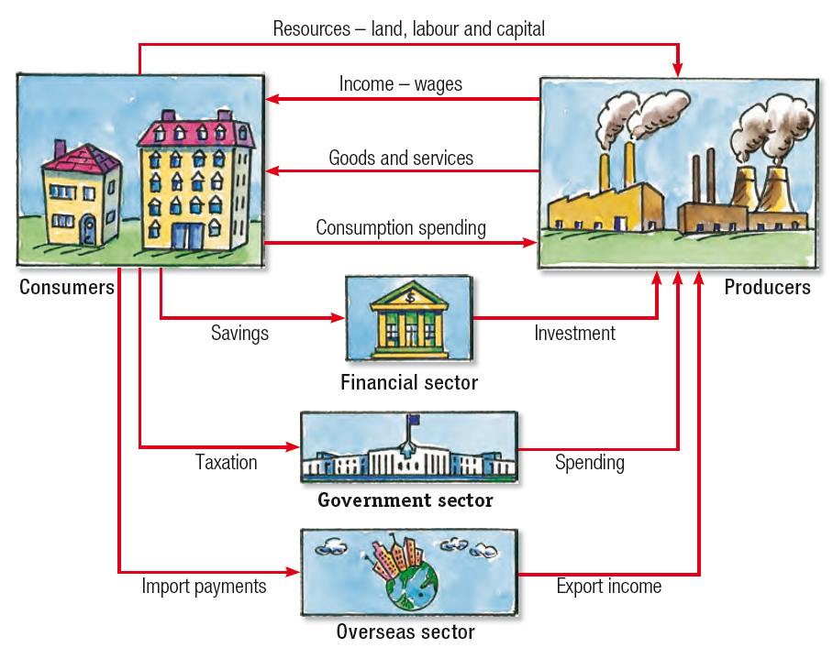
Models: many types
Human
Car
Ecosystem
Ecology & Evolution
Climate
Economy

Slide 57
When you make a model,
you include the
elements that you feel are most important to explain a phenomenon.

Slide 58
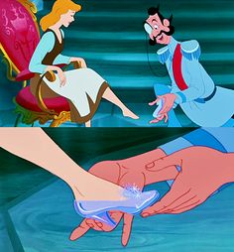
When you make a model,
you include the
elements that you feel are most important to explain a phenomenon.
Generally, we try to make models
that can reproduce real-world data

Slide 59
When you make a model,
you include the
elements that you feel are most important to explain a phenomenon.
Generally, we try to make models
that can reproduce real-world data
In E²M², we distinguish between statistical and mechanistic models

Slide 60
Statistical vs. Mathematical Model
The choice depends on the research question!

Slide 61
Statistical Models
Goal: To rigorously assess the strength of relationship between x and y

Slide 62
Statistical Models
Goal: To rigorously assess the strength of relationship between x and y
Find a significant relationship using a p-value as a measure of relationship strength

Slide 63
Statistical Models
Goal: To rigorously assess the strength of relationship between x and y
Find a significant relationship using a p-value as a measure of relationship strength
Statistical models can demonstrate correlations.

Slide 64
Statistical Models
Goal: To rigorously assess the strength of relationship between x and y (describe patterns)
Find a significant relationship using a p-value as a measure of relationship strength
Statistical models can demonstrate correlations.
Steps:
Formulate a research question
Formulate a hypothesis
Develop a model to demonstrate your hypothesis.
Collect data (required!!!)
Evaluate hypothesis with appropriate statistical tools
t-test, Chi-square, ANOVA
Ordination (PCA)
Regression (LM, GLM, GLMM, GAM)

Slide 65
1. Example Question: What is the trajectory of Malagasy population size through time?
Source: World Bank

Slide 66
1. Example Question: What is the trajectory of Malagasy population size through time?
2. Hypothesis: Malagasy population size increases with time
Source: World Bank

Slide 67
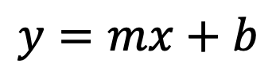
1. Example Question: What is the trajectory of Malagasy population size through time?
2. Hypothesis: Malagasy population size increases with time
3. Statistical Model:
$$y=mx+b$$
Linear Regression
Source: World Bank

Slide 68
1. Example Question: What is the trajectory of Malagasy population size through time?
4. Data:
2. Hypothesis: Malagasy population size increases with time
3. Statistical Model:
$$y=mx+b$$
Linear Regression
Source: World Bank

Slide 69
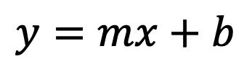
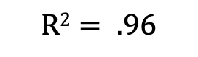

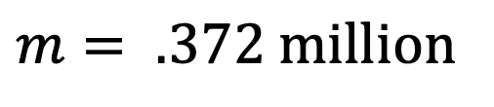
1. Example Question: What is the trajectory of Malagasy population size through time?
4. Data:
2. Hypothesis: Malagasy population size increases with time
3. Statistical Model:
5. Evaluation
Linear Regression
$$y=mx+b$$
$$m= .372 million$$
$$p= .003$$
$$R2= .96$$
What can we conclude from this fitted model?
Source: World Bank

Slide 70

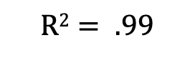

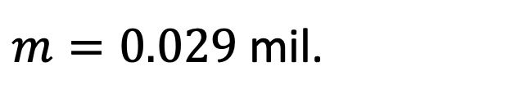
1. Example Question: What is the trajectory of Malagasy population size through time?
6. Adapt your model and re-evaluate:
Exponential Regression
$$y=e^{mx+b}$$
Exponential Regression
$m=0.029$ mil.
$$p<.001$$
$$R2= .99$$
What can we conclude from this fitted model?
Source: World Bank

Slide 71
Statistical Models: Beware!
Statistical models and tests are based on specific assumptions
data normally distributed
x and y independent

Slide 72
Statistical Models: Beware!
Statistical models and tests are based on specific assumptions
data normally distributed
x and y independent
Assessing a model means you need to make sure the assumptions are not violated.

Slide 73

Statistical Models: Beware!
Statistical models and tests are based on specific assumptions
data normally distributed
x and y independent
Assessing a model means you need to make sure the assumptions are not violated.
There are so many statistical models…

Slide 74
Statistical vs. Mathematical Model
The choice depends on the research question!

Slide 75
Mechanistic Models
Goal: To demonstrate the processes that underlie a relationship between x and y

Slide 76
Mechanistic Models
Goal: To demonstrate the processes that underlie a relationship between x and y
Find a significant relationship using a p-value as a measure of relationship strength.

Slide 77
Mechanistic Models
Goal: To demonstrate the processes that underlie a relationship between x and y
Find a significant relationship using a p-value as a measure of relationship strength
Mechanistic models can demonstrate causation.

Slide 78
Mechanistic Models
Goal: To demonstrate the processes that underlie a relationship between x and y
Find a significant relationship using a p-value as a measure of relationship strength
Mechanistic models can demonstrate causation.
Steps:
Formulate a research question
Formulate a hypothesis
Develop a model to demonstrate your hypothesis.
Collect data (for certain questions)
Evaluate the extent to which your model-simulated data matches that from the real world.

Slide 79
1. Example Question: How does Malagasy population size change with time?
2. Hypothesis: Malagasy population size increases because people are having children.
Can you think of an alternative hypothesis?
Source: World Bank

Slide 80
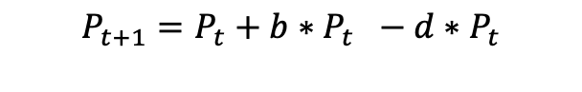
1. Example Question: How does Malagasy population size change with time?
2. Hypothesis: Malagasy population size increases because people are having children.
3. Mechanistic Model:
Population
birth
death
$$P_{t+1}=P_{t}+b∗P_{t} −d∗P_{t}$$
$$P_{t+1}=P_{t}+r∗P_{t}$$
Source: World Bank

Slide 81
1. Example Question: How does Malagasy population size change with time?
2. Hypothesis: Malagasy population size increases because people are having children.
3. Mechanistic Model:
4. Data:
Population
birth
death
$$P_{t+1}=P_{t}+b∗P_{t} −d∗P_{t}$$
$$P_{t+1}=P_{t}+r∗P_{t}$$
Source: World Bank

Slide 82
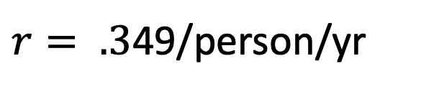
1. Example Question: How does Malagasy population size change with time?
2. Hypothesis: Malagasy population size increases because people are having children.
3. Mechanistic Model:
5. Evaluation:
4. Data:
Population
birth
death
$r= .3$49/person/yr
What can we conclude from this fitted model?

Slide 83
Mechanistic Models: Beware!
Parameters used in the mechanistic models sometimes are not measurable!

Slide 84
Mechanistic Models: Beware!
Parameters used in the mechanistic models sometimes are not measurable!
Simulations can be computationally intensive

Slide 85
Mechanistic Models: Beware!
Parameters used in the mechanistic models sometimes are not measurable!
Simulations can be computationally intensive
Advances in computational power often inspire development of more complex models which are not necessarily better

Slide 86
Mechanistic Models: Beware!
Parameters used in the mechanistic models sometimes are not measurable!
Simulations can be computationally intensive
Advances in computational power often inspire development of more complex models which are not necessarily better
“All models are wrong but some are useful…”
-George Box

Slide 87
Mechanistic Models: Beware!
Parameters used in the mechanistic models sometimes are not measurable!
Simulations can be computationally intensive
Advances in computational power often inspire development of more complex models which are not necessarily better
“All models are wrong but some are useful…”
-George Box
We use models to both predict and explain.

Slide 88
It is ideal when statistical and mechanistic models meet:
Mechanistic model
Process
Pattern
Statistical model

Slide 89

A Tool for E²M²
Computer power keeps increasing
Language/software
Fortran, C, C++
Julia, Java, Python
Matlab, Maple, Mathematica,
SAS, SPSS, Stata
Specific programs
Vortex, RAMAS, NetLogo for IBM
NicheMapper for physiology, iLand for forest dynamics
MaxEnt for species distribution modeling
Zonation for reserve selection etc…
The compromise: R---very powerful for
Visualization
Data formatting and sorting
Statistical analyses
Simulation (mechanistic model)

Slide 91
Goals for this lecture
To explain what we’re doing here
To define ”science”
To define ”data”
To define “models”
To introduce many different types of models
Statistical
Mathematical
To introduce the “E” in E²M²
Ecology
Epidemiology

Slide 92
Goals for this lecture
To explain what we’re doing here
To define ”science”
To define ”data”
To define “models”
To introduce many different types of models
Statistical
Mathematical
To introduce the “E” in E²M²
Ecology
Epidemiology

Slide 93
What is Epidemiology?
“the study of what is on the people”
– coined in 1802 to describe diseases in the Spanish population
Emphasis on the study and analysis of the distribution and determinants of health and disease (“risk factors”)

Slide 94
Models in Epidemiology
Sickness caused by an imbalance in the four humors (Hippocrates)

Slide 95
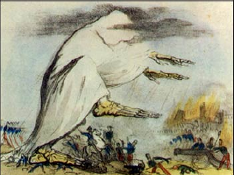
Models in Epidemiology
Sickness caused by an imbalance in the four humors (Hippocrates)
Miasmatic theory of disease (1500s)
Sickness results from emanations of ‘bad air’

Slide 96
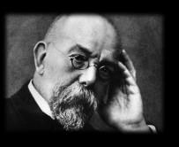
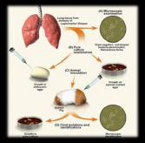
Models in Epidemiology
Sickness caused by an imbalance in the four humors (Hippocrates)
Miasmatic theory of disease (1500s)
Sickness results from emanations of ‘bad air’
Germ theory of disease
Leeuwenhoek’s microscope (1675)
Koch’s postulates (1890)

Slide 97
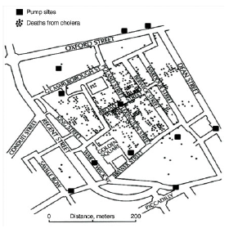
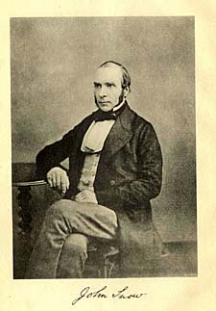
Models in Epidemiology
Sickness caused by an imbalance in the four humors (Hippocrates)
Miasmatic theory of disease (1500s)
Sickness results from emanations of ‘bad air’
Germ theory of disease
Leeuwenhoek’s microscope (1675)
Koch’s postulates (1890)
Classical epidemiology
John Snow and London cholera (1854)

Slide 98
Models in Epidemiology
Sickness caused by an imbalance in the four humors (Hippocrates)
Miasmatic theory of disease (1500s)
Sickness results from emanations of ‘bad air’
Germ theory of disease
Leeuwenhoek’s microscope (1675)
Koch’s postulates (1890)
Classical epidemiology
John Snow and London cholera (1854)
Mathematical epidemiology
Kermack and McKendrik (1927)
γ
S
βI or
βI/N
I
R
Susceptible
Infectious
Recovered

Slide 99
What is Ecology?
The study of the interactions of organisms and their environment
Coined in 1866 by German scientist Ernst Haeckel
Nile crocodiles opening mouths for sandpipers (Herodotus)
Emphasis on explaining dynamical processes in nature

Slide 100
Models in Ecology
Origins in plant biology and succession
Clements and Gleason (1910s-20s)

Slide 101
Models in Ecology
Origins in plant biology and succession
Clements and Gleason (1910s-20s)
Food Chains
- Charles Elton (1920s)

Slide 102
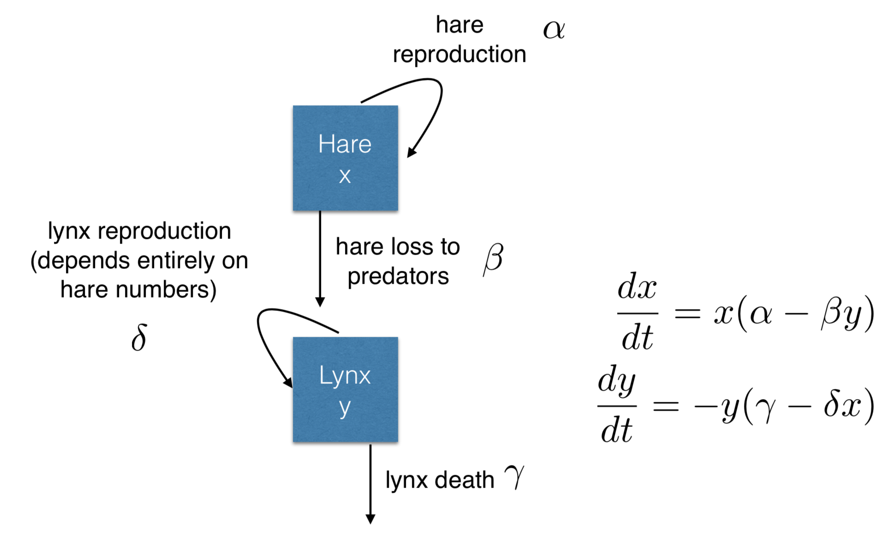
Models in Ecology
Origins in plant biology and succession
Clements and Gleason (1910s-20s)
Food Chains
- Charles Elton (1920s)
Predator-Prey Dynamics
- Lotka-Voltera (1920s)

Slide 103
Models in Ecology
Origins in plant biology and succession
Clements and Gleason (1910s-20s)
Food Chains
- Charles Elton (1920s)
Predator-Prey Dynamics
- Lotka-Voltera (1920s)
Mathematical Ecology
Robert MacArthur (1950s)
Island biogeography

Slide 104
Models in Ecology
Origins in plant biology and succession
Clements and Gleason (1910s-20s)
Food Chains
- Charles Elton (1920s)
Predator-Prey Dynamics
- Lotka-Voltera (1920s)
Mathematical Ecology
Robert MacArthur (1950s)
Island biogeography
Disease Ecology
Anderson and May (1980s)
Island biogeography
γ
S
βI or
βI/N
I
R
Susceptible
Infectious
Recovered

Slide 105
Friday: R Bootcamp
Intro to R Studio
Exploring and Visualizing Data in R
For-loops, Functions, and If-Else Statements
● Programming
● Data
● Models
● Research Development
Thursday: “Bells and Whistle”
● Introduction to Phylogenetic Modeling ● Tutorial
● Intoduction to Spatial Visualization and Plotting ● Tutorial
● Modeling Insights from the Metapopulation Game ● Tutorial
● Introduction to Network Modeling ● Tutorial
● Research Snapshots
Saturday: Travel
Sunday: “Getting Started with the Basics”
● Data and Models
● Student introductions & presentations
● Linear regression & simple statistics
● Linear regression tutorial
● Formulating research questions
Wednesday: “Refining Your Work”
● Model Fitting in Practice – the Basic Concept
● Epidemic Cards
● Model Fitting with Epidemic Cards
● Model Selection and Comparison
● Model Selection Tutorial
● Model Telephone
Friday: “Putting it All in Perspective”
● The Life Cycle of a Modeling Project
● C4C Student Presentations
Saturday: Travel
Monday: “Using Models with Data”
● Model-Guided Study Design
● Study design tutorial
● Intro to Compartmental Models & Differential Equations
● Building mechanistic models in R
● Refining research questions for modeling
● Defining a model world
January: “Sharing Your Work”
● Final student presentations
Tuesday: “Applying Simple Models”
● Dynamical Fever
● Introduction to Mixed Modeling
● Reading a Research Paper

Slide 106
Misaotra!

Slide 107


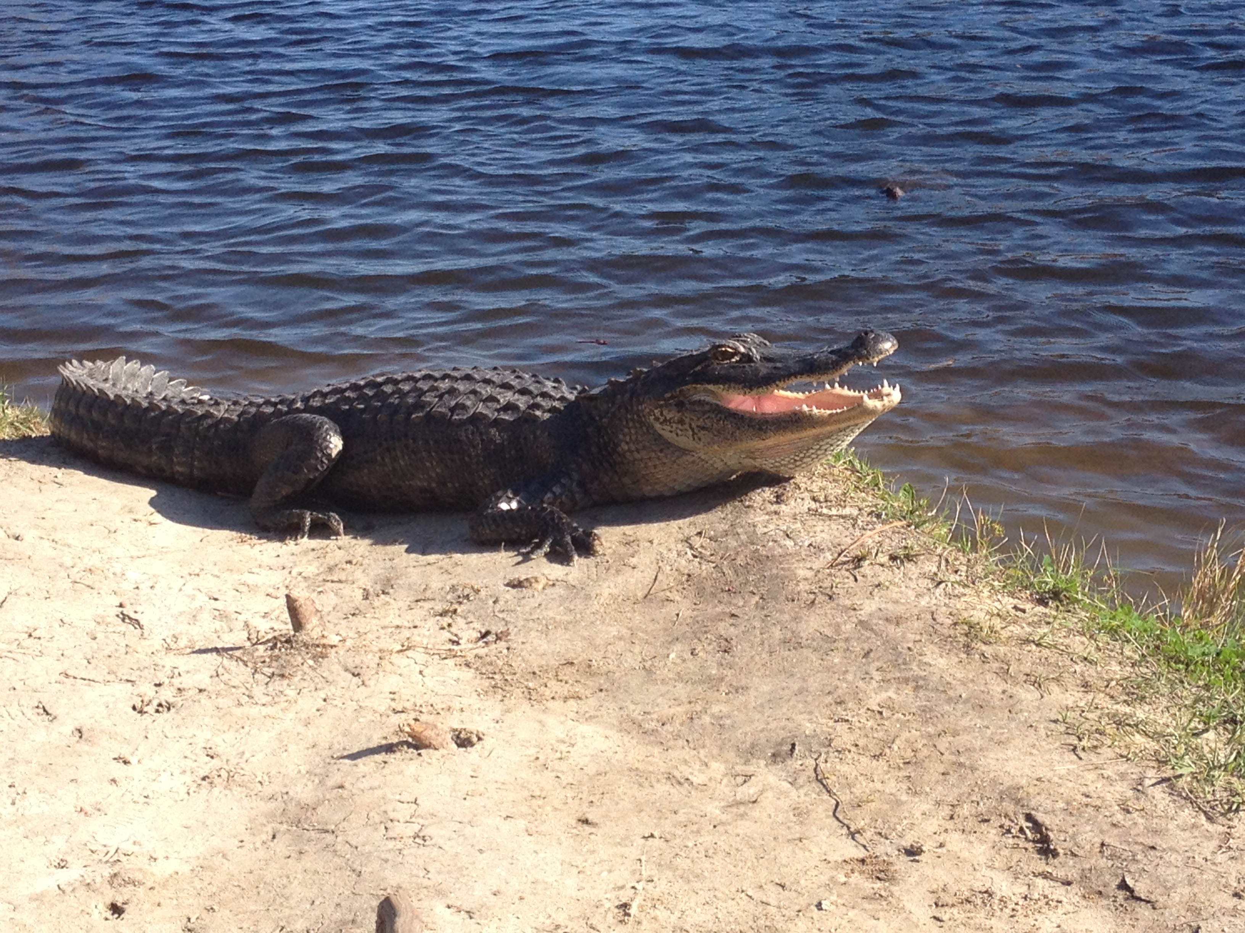
International Clinics on Infectious Disease, Dynamics, & Data
MMED: Clinic on the Meaningful Modeling of Epidemiological Data
May-June 2023, Cape Town, South Africa
DAIDD: Clinic on Dynamical Approaches to Infectious Disease Data
December 2023, Virtual
South African Center for Epidemiological Modeling and Analysis (SACEMA), Director
Dr. Juliet Pulliam
University of Stellenbosch
www.ici3d.org

